Slide 1
DSE5002 Project 1
Analysis of Data Science Salaries to Inform future hiring decisions
Peter Gyorda
April 18, 2025

Slide 2
Table of Contents
Table of Contents
Business Need, Project Objectives and Scope
Project Approach
Analysis
Conclusions and Recommendations

Slide 3
Business Need, Project Objectives and Scope
My company CEO would like an analysis of Data Scientist salaries to inform their hiring decisions
My company’s CEO has decided that the company needs a full-time data scientist, and possibly a team of them in the future
She thinks she needs someone who can help drive data science within the entire organization and could potentially lead a team in the future
She understands that data scientist salaries vary widely across the world and is unsure what to pay them. To complicate matters, salaries are going up due to the great recession and the market is highly competitive
My CEO has asked you to prepare an analysis on data science salaries and provide them with a range to be competitive and get top talent. The position can work offshore, but the CEO would like to know what the difference is for a person working in the United States
Projective Objectives
Perform an Analysis of current data scientist salaries to understand the best options for the company to hire a data scientist and potentially a larger team in the near future
Make a recommendation to the CEO on what the best path should be for the company

Slide 4
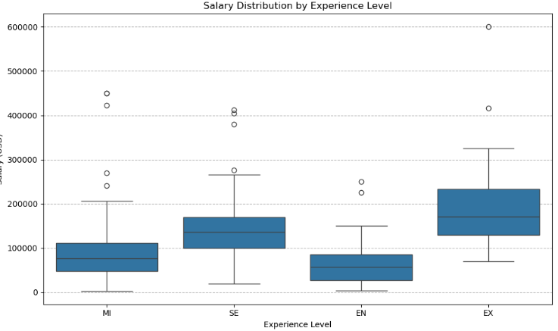
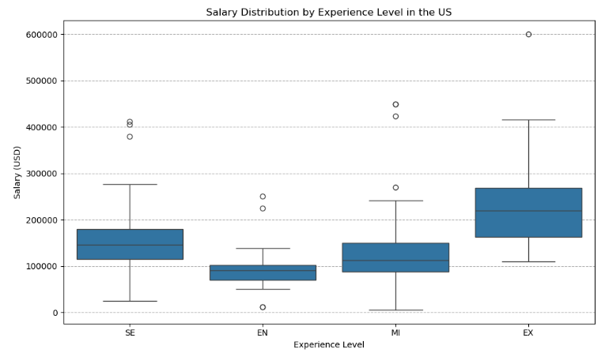
Data Analysis
Average Salaries by experience level
In the file of Data Scientist salaries, there were 607 salaries analyzed across various countries (N=50), experience levels and size of companies employing the Data Scientists. All salary information was converted into US $ and is represented below and in the following slides.
Table 1. Average salary by experience level – All Countries
Experience level | Average salary | Low end of range | Upper end of range
Entry Level (EN) | $61,643 | $27,505 | $85,425
Mid Level (MI) | $87,996 | $48,000 | $112,000
Senior Level (SE) | $138,617 | $100,000 | $170,000
Expert Level (EX) | $199,392 | $130,006 | $233,750
NOTE: “Low end of range” and “Upper end of range” is the lower end and upper end of the quartile range represented in the box plots.
Table 2. Average salary by experience level – US only
Experience level | Average salary | Low end of range | Upper end of range
Entry Level (EN) | $93,113 | $70,000 | $102,500
Mid Level (MI) | $125,780 | $87,750 | $150,000
Senior Level (SE) | $151,528 | $115,234 | $180,000
Expert Level (EX) | $243,742 | $163,406 | $268,500

Slide 5
Data Analysis
Average Salaries by country
There were 50 countries listed in the data set, and we have provided the 10 countries with highest average salary and the 10 countries with lowest average salary.
Table 3. Top 10 Countries with highest average salary (USD)
Table 4. Bottom 10 Countries with lowest average salary USD
Country | Average salary | Low end of range | Upper end of range
Russia (N=2) | $157,500 | $121,250 | $193,750
United States (N=355) | $144,055 | $100,000 | $170,000
New Zealand (N=1) | $125,000 | $125,000 | $125,000
Israel (N=1) | $119,059 | $119,059 | $119,059
Japan (N=6) | $114,127 | $66,283 | $145,341
Australia (N=3) | $108,043 | $87,064 | $118,712
UAE (N=3) | $100,000 | $90,000 | $117,500
Algeria (N=1) | $100,000 | $100,000 | $100,000
Iraq (N=1) | $100,000 | $100,000 | $100,000
Canada (N=30) | $99,824 | $69,730 | $117,916
Country | Average salary | Low end of range | Upper end of range
Turkey (N=3) | $20,097 | $16,137 | $24,094
Honduras (N=1) | $20,000 | $20,000 | $20,000
Brazil (N=3) | $18,603 | $15,904 | $21,454
American Samoa (N=1) | $18,053 | $18,053 | $18,053
Moldova (N=1) | $18,000 | $18,000 | $18,000
Ukraine (N=1) | $13,400 | $13,400 | $13,400
Pakistan (N=3) | $13,333 | $10,000 | $16,000
Kenya (N=1) | $9,272 | $9,272 | $9,272
Iran (N=1) | $4,000 | $4,000 | $4,000
Vietnam (N=1) | $4,000 | $4,000 | $4,000
NOTE: The number of data points in each country is listed as “N=“. All values rounded to the nearest US dollar.
NOTE: The number of data points in each country is listed as “N=“. All values rounded to the nearest US dollar.
Given the limited number of data points/salaries in many markets, it is difficult to draw conclusions with this data. Another analysis was run to evaluate countries that had better salary information.

Slide 6
Data Analysis
Average Salaries by country (Continued)
Given the low number of data points in many country markets, the data analysis was further refined by combining all of the countries that had at least 10 data points to get more confidence in the overall analysis.
Table 5. Countries with >10 Data Scientist salaries. Sorted by Average salary
Key points
The United States had the highest salaries while India was substantially lower than other countries Canada had the next highest salary but was far below the US Many of the countries were based in Europe with Germany and Great Britain having the highest number of data points and also among the highest salaries
Country | Average salary | Low end of range | Upper end of range
United States (N=355) | $144,055 | $100,000 | $170,000
Canada (N=30) | $99,824 | $69,730 | $117,916
Germany (N=28) | $81,887 | $58,986 | $90,734
Great Britain (N=47) | $81,583 | $57,575 | $103,931
France (N=15) | $63,971 | $48,202 | $69,143
Spain (N=14) | $53,060 | $40,074 | $68,793
Greece (N=11) | $52,293 | $42,078 | $60,453
India (N=24) | $28,582 | $16,735 | $32,163
NOTE: The number of data points in each country is listed as “N=“. All values rounded to the nearest US dollar.

Slide 7
Conclusions
Recommendations
The data clearly showed that the US has the highest salaries however there are opportunities to offshore in other country markets. The data also highlighted that there are a number of options to hire at different levels and would recommend hiring at least a senior level employee in order to establish the Data Science team
Recommendations and Conclusions
The data in Table 1 clearly shows that there are a number of options to hire Data Scientists at different levels. Given that the company would like to initially hire a Data Scientist and potentially build a entire department, it is recommended to hire Senior Level Data Scientist which could establish a team. It is not recommended at this point to hire an Expert but however if the right candidate is available, then it is a possibility to do so. The average salary for a Senior Level Data Scientist is $138,617 with a range of $110,000 - $170,000. NOTE: Average salary and range calculated for all country markets
Since the company is based in the US, it is recommended to hire the Senior Level Data Scientist somewhere in the US. Ideally the candidate would be local to the company's headquarters, but this is negotiable. The average salary for a Senior Level Data Scientist in the US is $151,528 with a range of $115,234 - $180,000 (see Table 2)
If there is flexibility to have this person work offsite, then Canada would be a great location due to the overlapping time zones with the US and average salaries are much lower (See Table 5).
Once the group is established, then a offshore team could be established where data scientists can be used from other regions to build out the team. Countries to consider would be Great Britain and Germany which have a much lower average salary rate than the US. (See Table 5)
India has the cheapest labor rates however there maybe challenges working across time zones and therefore it would require hiring people to overlap for at least part of the day with the US. Working with offshore teams in India is commonly done so this isn’t a major issue but would require greater planning.

Slide 8
Data Analysis
Average Salaries by experience level
In the file of Data Scientist salaries, there were 607 salaries analyzed across various countries (N=50), experience levels and size of companies employing the Data Scientists. All salary information was converted into US $ and is represented below and in the following slides.
Table 1. Average salary by experience level
Experience level | Average salary | Low end of range | Upper end of range
Entry Level (EN) | $61,643 | $27,505 | $85,425
Mid Level (MI) | $87,996 | $48,000 | $112,000
Senior Level (SE) | $138,617 | $100,000 | $170,000
Expert Level (EX) | $199,392 | $130,006 | $233,750
NOTE: “Low end of range” and “Upper end of range” is the lower end and upper end of the quartile range represented in the box plots.

Slide 9
Data Analysis
Average Salaries by country (Continued)
Given the low number of data points in many country markets, the data analysis was further refined by combining all of the countries that had at least 10 data points to get more confidence in the overall analysis.
Table 4. Countries with >10 Data Scientist salaries. Sorted by Average salary
Country | Average salary | Low end of range | Upper end of range
United States (N=355) | $144,055 | $100,000 | $170,000
Canada (N=30) | $99,824 | $69,730 | $117,916
Germany (N=28) | $81,887 | $58,986 | $90,734
Great Britain (N=47) | $81,583 | $57,575 | $103,931
France (N=15) | $63,971 | $48,202 | $69,143
Spain (N=14) | $53,060 | $40,074 | $68,793
Greece (N=11) | $52,293 | $42,078 | $60,453
India (N=24) | $28,582 | $16,735 | $32,163
NOTE: The number of data points in each country is listed as “N=“. All values rounded to the nearest US dollar.

